Slide 1


Entities, Coreference, Discourse, etc.
Hal Daumé III
School of Computing
University of Utah
me@hal3.name

Slide 2
About Summarization Research
There are a wealth of document/abstract pairs that statistical
summarization systems could leverage to learn how to create novel
abstracts. Detailed studies of such pairs~\cite{jing:cl} show that
human abstractors perform a range of very sophisticated operations
when summarizing texts, which include reordering, fusion, and
paraphrasing. Unfortunately, existing document/abstract alignment
models are not powerful enough to capture these operations. To get
around directly tackling this problem, researchers in text
summarization have employed one of several techniques.
Some researchers~\cite{bankoetal00} have developed simple statistical
models for aligning documents and headlines. These models, which
implement IBM Model 1~\cite{brownetal93}, treat documents and
headlines as simple bags of words and learn probabilistic word-based
mappings between the words in the documents and the words in the
headlines. As our results show, these models are too weak for
capturing the operations that are employed by humans in summarizing
texts beyond the headline level.
Other researchers have developed models that make unreasonable
assumptions about the data, which lead to the utilization of a very
small percent of available data. For instance, the document and
sentence compression models of Daum\'e III, Knight, and
Marcu~\cite{knight-marcu02,daume-marcu02} assume that
sentences/documents can be summarized only through deletion of
contiguous text segments. Knight and Marcu found that from a corpus
of $39,060$ abstract sentences, only $1067$ sentence extracts existed:
a recall of only $2.7\%$.
Sentence Extraction
  Given a document, identify and extract important sentences
  Special models to handle redundancy
  Typically trained on manually annotated or automatically annotated extracts

Slide 3
About Actual Summaries
Are not extracts
  The sentence is not an appropriate level of granularity
Are not compressions
  Involve lots of rewriting and reordering
Are not bags of words
  Are fluent, grammatical, etc.
So why do we focus on these unrealistic problems?
DATA!

Slide 4
Learning Transformations
Document/Abstract pairs:
Connecting Point has become the single largest Mac retailer.
CP Systems tripled it's sales of Macintosh systems; it is now the single largest seller of Macintosh.
English/French pairs:
Connecting Point has become the single largest Mac retailer.
L' Pointe de Connecting bécomé l' retailerese oné-most largezze Macintosh.
How does MT solve this problem?
Alignments!!!

Slide 5
Results
System Precision Recall F-Score
Human 1
Human 2
GIZA-HMM
GIZA-Model 4
GIZA-HMM (flipped)
GIZA-Model 4 (flipped)
Decomposition
PBHMM
0.727 0.746 0.736
0.680 0.695 0.687
0.120 0.260 0.164
0.117 0.260 0.161
0.295 0.250 0.271
0.280 0.247 0.262
0.349 0.379 0.363
0.456 0.686 0.548

Slide 6
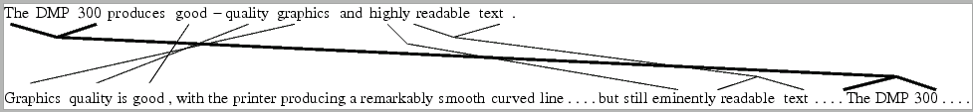
Sources of Error

Slide 7
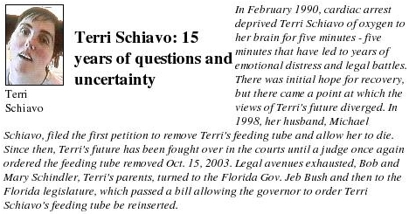
Entity Detection and Tracking
Name
Pronoun
Premodifier
Nominal

Slide 8
Entity Detection and Tracking
Official formulation:
  Identify all entities appearing in a document and the textual spans (mentions) that refer to these entities
Typical interpretation:
  Identify all mentions appearing in a document and discern which mentions refer to the same entity
Identifying mentions also involves mention types:
  Name (NAM), Nominal (NOM), Pronoun (PRO), Premodifier (PRE)
Identifying entities also involves entity types:
  Person, Organization (+5 subtypes), GPE (+10), Location (+6), Facility (+8), Vehicle (+5), Weapon (+9)

Slide 9

Mention Detection
Use BIO-encoding to obtain sequence labeling problem:
Now, if we make a Markov assumption on the labels, we can apply any standard sequence labeling model:
  HMM, MEMM, CRF, M3N, ...
... Bob and Mary Schindler , Terri 's parents ,
B-Per I-Per I-Per I-Per O B-Per O B-Per O
turned to the Florida Gov. Jeb Bush and then ...
O O O B-GPE B-Per B-Per I-Per O O

Slide 10
Coreference Resolution
- the President United States
- the President Congress
+ the President he
- the President them
...
- United States Congress
- United States he
+ United States the country
...
- the country he
...
Today, the President
of the United States
addressed Congress.
He told them that he
planned on giving a
speech tomorrow,
during which he
would announce to
the country that he
had decided to ...
Your Favorite
ML Algorithm
Original
Training Data
Binary Training Pairs
? the President United States
? the President Congress
? the President he
? the President them
...
? United States Congress
? United States he
? United States the country
...
? the country he
...
- the President United States
- the President Congress
+ the President he
- the President them
...
- United States Congress
+ United States he
+ United States the country
...
- the country he
...
Today, the President
of the United States
addressed Congress.
He told them that he
planned on giving a
speech tomorrow,
during which he
would announce to
the country that he
had decided to ...
f
Test Data
Binary Test Pairs
Your Favorite
Clustering
Algorithm
Today, the President
of the United States
addressed Congress.
He told them that he
planned on giving a
speech tomorrow,
during which he
would announce to
the country that he
had decided to ...

Slide 11
Coreference Resolution
Choosing a classifier
  How should we tune it?
  Can we train on all pairs?
Choosing training instances
  Use all pairs? Most recent negatives only? Samples?
  What about the i.i.d. assumption?
Choosing a clustering algorithm
  How does this choice interact with the classifier?
  How can we tune parameters?

Slide 12
Two Successful Approaches
Classifier:
  Maxent multilabel classifier
Instances:
  All pairs
Clustering:
  Use a max-link beam search (the Bell-tree algorithm)
  [Florian et al., 2004]
Classifier:
  Perceptron-trained CRF
Instances:
  All pairs
Clustering:
  Use generic graph partitioning algorithms
  [McCallum & Wellner, 2004]

Slide 13
Summary of Previous Approaches
Mention Detection:
  Tractable under Markov assumption
  Inference requires evaluation of forward/backward (sum-product) algorithm for likelihood or margin-based training
    For perceptron training, requires evaluation of Viterbi algorithm
  Prediction requires evaluation of Viterbi (max-product) algorithm
Coreference Resolution:
  Full inference is never tractable
  Only the McCallum & Wellner model solves the problem directly
    But has to resort to very simple Perceptron-style updates
  For the most part, non-integrated classification + clustering
  Features are usually simple pairwise-comparisons

Slide 14
Features
Lexical: unigrams (words); the bigrams; the two character prefixes and suffixes; the word stem; the case of the word, computed by regular expressions.
Syntactic: unigrams and bigrams of part of speech as well as shallow-parse features.
Semantic: two most common synsets; all hypernyms; for coreference, distance in the WordNet graph between pairs of head words whether one is a part of the other; synset and hypernym information of the preceding and following verbs.
Lists: about 40 lists of common places, organization, names, etc.
Class: word clusters
Inference: models to predict number and gender; output of MEMMs trained off of the MUC6, the MUC7 and ACE data.
String: string match; substring match; string overlap; pronoun match; and normalized edit distance; string nationality match; linguistically-motivated string edit distance; Jaro distance; acronym match.

Slide 15
Performance
Name to Name mid to high 90s
Name to Pronoun mid 80s
Name to Nominal 40s-50s

Slide 16
Hobbs' Distance
The castle remained the of the until he moved it to London
in Camelot residence king

Slide 17
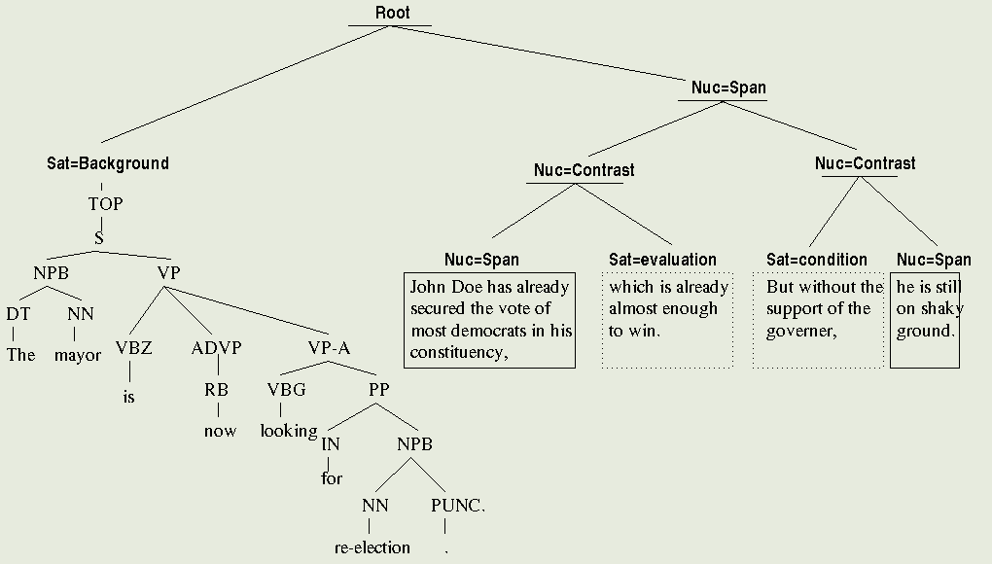
Discourse “Hobbs' Distance”

Slide 18
Does Discourse Distance hold?
Holds perfectly in ~ 55%
60% of remaining are ATTRIBUTION
85% of remaining binuclear

Slide 19
Distribution of Entities
Expectation
Truth

Slide 20

Name/Instance Data
12416 Palestinian leader Yasser Arafat
5772 Bosnian Serb leader Radovan Karadzic
3839 White House spokesman Mike McCurry
3660 Foreign editor Rick Christie
3654 News editor Art Dalglish
3228 State Department spokesman Nicholas Burns
3089 White House spokesman Marlin Fitzwater
2528 PLO leader Yasser Arafat
2157 first lady Hillary Rodham Clinton
2069 spokesman Alexander Ivanko
1677 Soviet leader Mikhail Gorbachev
1646 envoy Richard Holbrooke
1585 Libyan leader Moammar Gadhafi
1196 envoy Dennis Ross
1195 Communist leader Gennady Zyuganov
1152 White House spokesman Joe Lockhart
1109 Turkish Cypriot leader Rauf Denktash
1057 White House press secretary Mike McCurry

Slide 21
Using Name/Instance Data

Slide 22
Gazetteers
census data and baby name books
standard gazetteers
(countries, cities, islands, ports, provinces and states)
airport locations
company names (NASDAQ and NYSE)
semantically plural words
list of persons, organizations and locations
that were identified by IdentiFinder.

Slide 23
Using Gazetteers for Coref
list_of(anaphor) + lexeme_of(antecedent)
list_of(anaphor) + list_of(antecedent) + same_word?

Slide 24
WordNet
Distance in graph?
Hyponym/Hypernym?
Japan Russia
Nearest-verb hypernyms

Slide 25
Count-based Features
total # of entities detected
total # of mentions
Ratios:
  entity:mention ratio
  entity:word ratio
  mention:word ratio
  # of mentions in the current chain to the total # of mentions
size of the hypothesized chain
# of intervening mentions
# of intervening mentions of the same type; # of intervening sentence breaks
decayed density

Slide 26
Feature Contributions
-Lex
-Disc
-Pat
-Cou
-Sem
-KB
-Cla
-Lst
-Inf
-Str
88.9
89.1
88.5
86.9
89.1
88.9
88.7
89.0
88.9
83.6
87.6
88.6
87.1
89.2
88.6
88.9
88.9
88.8
83.7
87.6
88.7
87.5
89.1
89.2
89.2
88.8
85.2
87.6
89.0
87.2
88.7
88.9
88.8
84.3
86.5
86.9
88.5
88.7
88.4
83.2
86.7
86.8
87.9
88.3
78.3
86.2
86.5
87.6
78.5
85.5
85.6
77.6
84.9
76.7
Str > Lex > Cou > KB > Inf > Lst > Pat > Cla > Sem > Disc

Slide 27
Linkage Types
When hypothesizing merging a mention into a chain, to which chain element to we 'attach?'
    Sum/Average link (default)
    Min link
    Max link (commonly used)
    Last link (commonly used)
    First link
    Intelligent link:
      NAM: first(NAM) + last(NOM) + max
      NOM: max(NOM) + last(NAM) + max
      PRO: avg(PRO+NAM) + max

Slide 28
Linkage Types

Slide 29
Errors Pre-Engineering

Slide 30
Errors Post-Engineering

Slide 31
Discussion
Learning makes a difference (LaSO → Searn)
Feature engineering makes a bigger one
Many features not obvious
⇉ LOOK at outputs!
Be clever!

